Slide 1
THE PELVIC REPRODUCTIVE ORGANS
The Male Urethra
The male urethra extends from an internal orifice at the bladder neck to an external orifice at the free extremity of the penis. It is thus divisible into an internal or pelvic part and an external or spongy part that refers to the very vascular tissue that surrounds the urethra on its leaving the pelvic cavity. The spongy part is largely united within the penis and is considered as a component of that organ. The pelvic part is joined by the deferent and vesicular (or combined ejaculatory) duct(s) a short distance from its origin from the bladder; by far the greater part of the urethra thus serves to discharge both urine and semen.

Slide 2
1
2
3
4
5
5
6
; 6
7
7
stallion
bull
boar
Accessory reproductive glands dorsal view. 1, Ureter; 2,
bladder; 3, deferent duct; 4, ampullary gland; 5, vesicular
gland; 6, body of prostate; 7, bulbourethral gland; 8, urethra,
9, bulb of penis.
4
6
dog

Slide 3
The Accessory Reproductive Glands
The full set comprises ampullary, seminal Vesicles, prostate, and bulbourethral glands, although not all of these are present in every species .
1- The ampullary glands have been sufficiently described.
2- Paired vesicular glands are present in all domestic species except the dog and cat. In the pig the gland to open separately .These glands vary greatly in appearance; in the stallion they are large, externally smooth, and bladder-like, resembling . The vesicular glands lie wholly or partly within the genital fold, each lateral to the corresponding deferent duct.

Slide 4
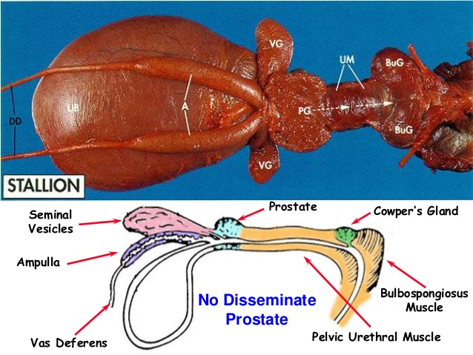

Slide 5
A prostate , is present in all domestic species. In some it consists of two parts: one is diffusely spread within the wall of the pelvic urethra, and the other is a compact body placed external to the urethralis. Both parts drain by many small ducts. The small ruminants have only the diffuse and the horse only the compact part. The diffuse part is vestigial in the dog and cat, but the compact part is very large and globular and so well developed that it surrounds the urethra entirely (dog) or almost so (cat).

Slide 6
Paired bulbourethral glands compound tubular glands with a secretory epithelium, lie on the dorsal aspect of the urethra close to the pelvic exit. They are found in all species other than the dog (although they are vestigial in the cat). They are of moderate size in horses and ruminants but are very substantial in the pig, in which they appear as rather irregular elongated cylinders placed to each side of the urethra. They may drain by one or by several ducts. All the larger glands possess well-developed capsules and internal septa in which much smooth muscle is present that expels the secretion at the appropriate time.

Slide 7
Penis
The penis is suspended below the trunk and is partly contained between the thighs, where it is attached to the floor of the pelvis by a suspensory ligament in the large species. In the quiescent state, the free extremity is concealed within an invagination of the abdominal skin, the prepuce, which opens at a variable site behind the umbilicus. The organ is mainly consist of three columns of erectile tissue . The paired dorsal columns are known as the crura of the penis(سيقان القضيب ) at their widely separated origins from the ischial arch. They converge, bend forward, and run below the pelvic floor before joining.

Slide 8
Each consists of a core of cavernous tissue enclosed within a thick connective tissue casing (tunica albuginea known as a corpus cavernosum.
A septum exists between the two corpora cavernosa in the proximal part of the body, but in most species this will disappear distally toward the apex of the penis. In carnivores the septum is complete. The combined structure is grooved ventrally to contain the third component, the urethra within its enveloping vascular sleeve, the corpus spongiosum.

Slide 9
2
1
4
7
3
8
6
5
9
Schematic drawing of the components that constitute the equine penis at its root and at its apex. 1, Crus penis; 2, bulb; 3, corpus spongiosum; 4, corpus cavernosum; 5, urethra; 6, bladder; 7, ureter; 8, deferent duct; 9, glans.

Slide 10
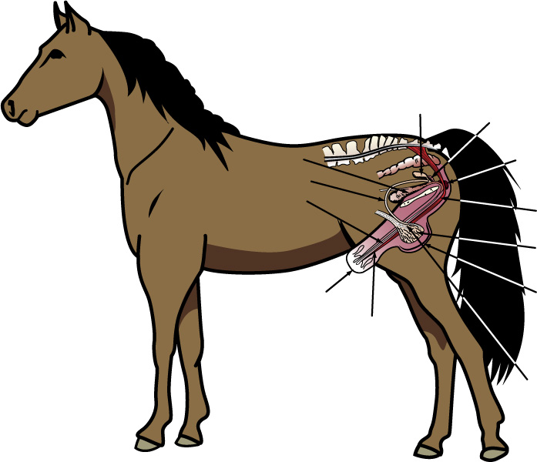

Slide 11
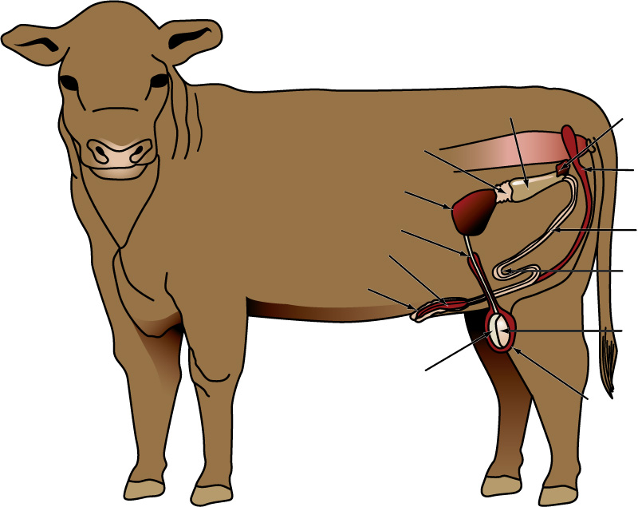

Slide 12
The corpus spongiosum is more delicate than the corpus cavernosum, having larger blood spaces separated by thinner septa .The cranial expansion over the distal end of the corpus cavernosum, usually known as the glans , forms the apex of the whole organ. Since the corpus spongiosum surrounds the urethra, the urethral orifice is brought to the distal extremity of the penis. In small ruminants a free urethral process prolongs the urethra well beyond this.

Slide 13
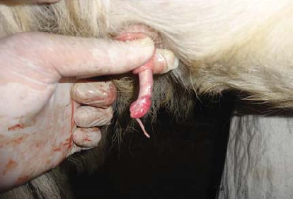

Slide 14
In the dog and cat the distal part of the corpus cavernosum is transformed into bone, the os penis. The glans has very different forms. It is minimally developed in the pig, insubstantial(لاقيمة لها) in the ruminants, but large and mushroom-shaped in the horse. It is most specialized in the dog, in which it presents bulbar proximal and long cylindrical distal parts.

Slide 15
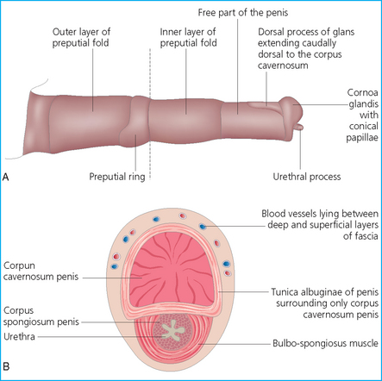

Slide 16
The penis of the boar and ruminant species in which the quiescent organ exhibits a sigmoid flexure carried between the thighs. In the other type, the blood spaces are relatively larger, and the septa more delicate and more muscular , a relatively much greater quantity of blood is required to achieve erection, which involves significant increases in both length and bridth. This musculocavernous type of penis is found in the stallion while Fibroelastic in Bull, boar, buck, ram.

Slide 17
1
1
2
2
3
B
A).
4
5
Transverse sections of the musculocavernous penis of a stallion (A). And fibroelastic penis of a bull (B ) 1, Tunica albuginea; 2, corpus cavernosum; 3, septum; 4, urethra; 5, corpus spongiosum; 6, bulbospongiosus.

Slide 18
The prepuce or sheath is a tubular fold consisting of an external layer (lamina externa), continuous with the general integument, and an internal layer (lamina interna) that faces the free end of the penis; the internal layer continues as the covering of the free part of the penis after reflection in the depth of the preputial cavity.

Slide 19
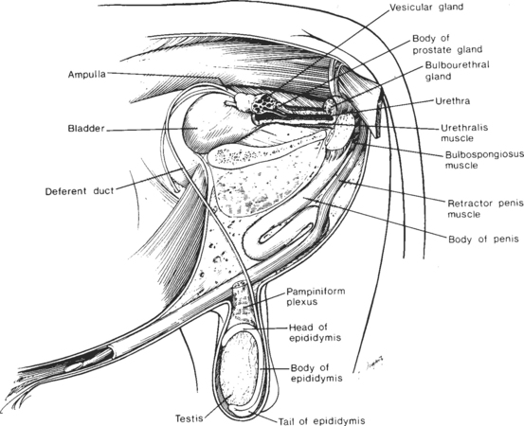

Slide 20
